Slide 1
Autonomic and Somatic responses

Slide 2
Autonomic Nervous System (ANS)
Part of the Peripheral Nervous System (PNS)
Responsible for the control of the body’s internal environment – A very important component in the maintenance of homeostasis.
Regulated by nerve cells in the medulla, hypothalamus and the cerebral cortex.

Slide 3
Autonomic Nervous System (ANS)
Regulates:
  Heart rate
  Blood pressure
  Body temperature
  Digestion
  Release of energy
  Pupil diameter
  Breathing
  Defecation and urination

Slide 4
Refresh - Ganglion
A group of nerve cell bodies found outside of the CNS
Most cell bodies are found in the CNS usually grey matter of the brain.

Slide 5
Nerve fibre pathway – Autonomic vs Somatic (motor neurons ONLY)
The pathway travelled by a nerve impulse to a cell controlled by the ANS:
Two neurons – the second neuron has it’s cell body in a ganglion. A synapse is required
  (the somatic nervous system contains only one motor neuron sending an impulse from the CNS direct to the effector. No synapse)
Human Perspective 8th ed. Page 89, figure 4.17

Slide 6
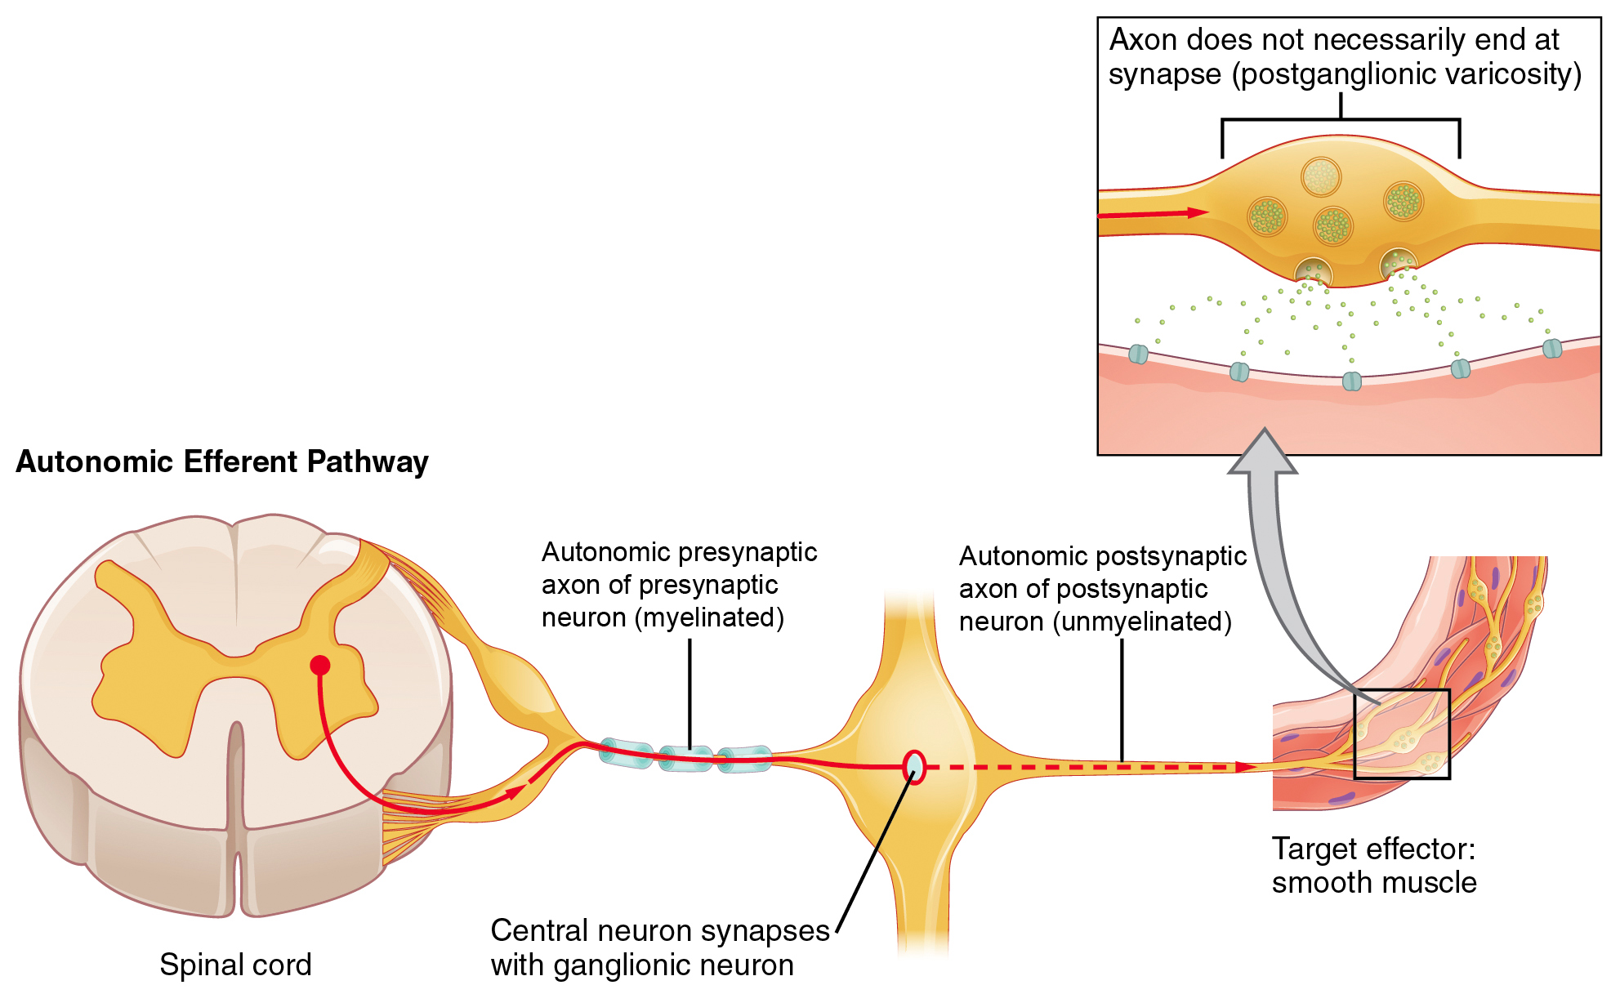
ANS Motor Neuron Pathway (Efferent)

Slide 7
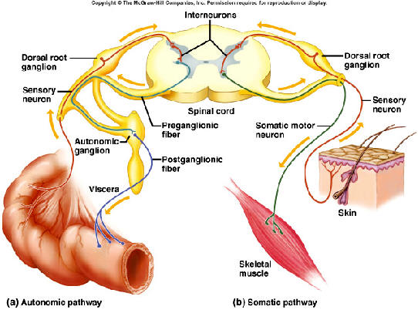
- Number of nerve fibres (motor and sensory)
- Autonomic vs Somatic

Slide 8
Further divisions of the ANS
Two sets of nerve fibres send impulses to an organ. The ANS is responsible for acting on an organ in one of 2 ways – excitation or inhibition. Hence, 2 sets of nerve fibres. The two ANS divisions are:
  Sympathetic (Fight or Flight) – prepare the body for strenuous activity (generally excitation)
  Parasympathetic (Rest and Digest) – responses for the body in quiet conditions (generally inhibition)
Somatic responses have only one set of nerve fibre/s going to the effector. This is due to somatic responses only causing excitation (of skeletal muscle).

Slide 9
Neurotransmitters
ANS makes use of acetylcholine and noradrenaline at the neuromuscular junction
Somatic pathways makes use of acetylcholine at the neuromuscular junction.

Slide 10
Characteristic | Autonomic division | Somatic division
Effectors | Heart muscle, involuntary muscle, glands | Skeletal (voluntary) muscles
General function | Adjustment of the internal environment (homeostasis) | Response to the external environment
Efferent (outward) pathways | Two nerve fibres from the CNS to the effector with a synapse in a ganglion | One nerve fibre from the CNS to the effector; no synapse and no ganglion
Neurotransmitter at effector | Acetylcholine or noradrenaline | Acetylcholine
Control | Usually involuntary | Usually voluntary
Nerves to target organ | Two sets—sympathetic and parasympathetic | One set
Effect on target organ | Excitation or inhibition | Always excitation

Slide 11
Structure | Effect of sympathetic stimulation | Effect of parasympathetic stimulation
Heart | Increases rate and strength of contraction | Decreases rate and strength of contraction
Lungs | Dilates bronchioles (fine air passages in the lungs) | Constricts bronchioles
Stomach, intestines | Decreases movement | Increases movement
Liver | Increases breakdown of glycogen and release of glucose | Increases uptake of glucose and synthesis of glycogen
Iris of the eye | Dilates pupil | Constricts pupil
Sweat glands | Increases sweat secretion | No effect

Slide 12
Structure | Effect of sympathetic stimulation | Effect of parasympathetic stimulation
Salivary glands | Decreases secretion of saliva | Increases secretion of saliva
Blood vessels of: skin skeletal muscle internal organs | Constricts vessels Dilates vessels Constricts vessels (except in heart and lung) | Little effect No effect Little effect
Urinary bladder | Relaxes muscles of wall | Constricts muscles of wall
Adrenal medulla | Stimulates hormone secretion | No effect

Slide 13
Fight or flight response
This is controlled by the ANS. The sympathetic division is stimulated resulting in:
The effects described on the previous two slides
The hormones released by the adrenal medulla are adrenaline and noradrenaline which causes the above response to be intensified and prolonged.

Slide 14
Characteristic | Nervous system | Endocrine system
Nature of message | Electrical impulses and neurotransmitters | Hormones
Transport of message | Along the membrane of neurons | By the bloodstream
Cells affected | Muscle and gland cells; other neurons | All body cells
Type of response | Usually local and specific | May be very general and widespread
Time taken to respond | Rapid—within milliseconds | Slower—from seconds to days
Duration of response | Brief—stops quickly when the stimulus stops | Longer lasting—response may continue long after the stimulus has stopped

